Slide 1
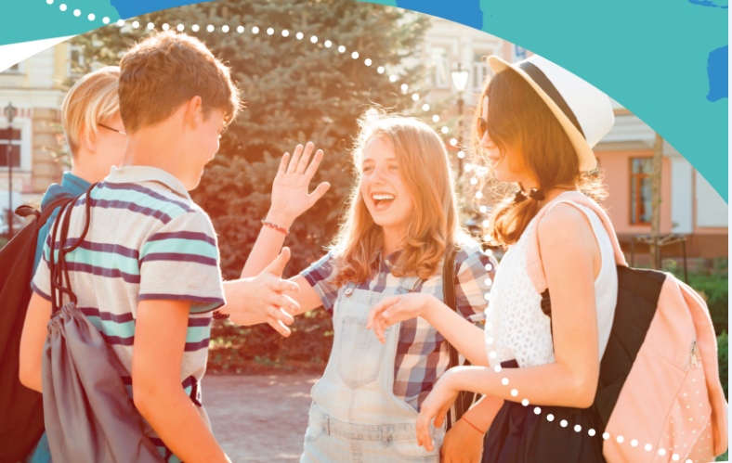


UNIT 6:
Around the world
Not so ordinary
hobbies

Slide 2
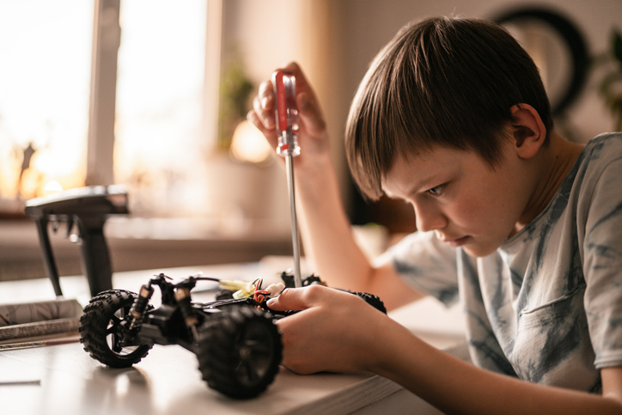
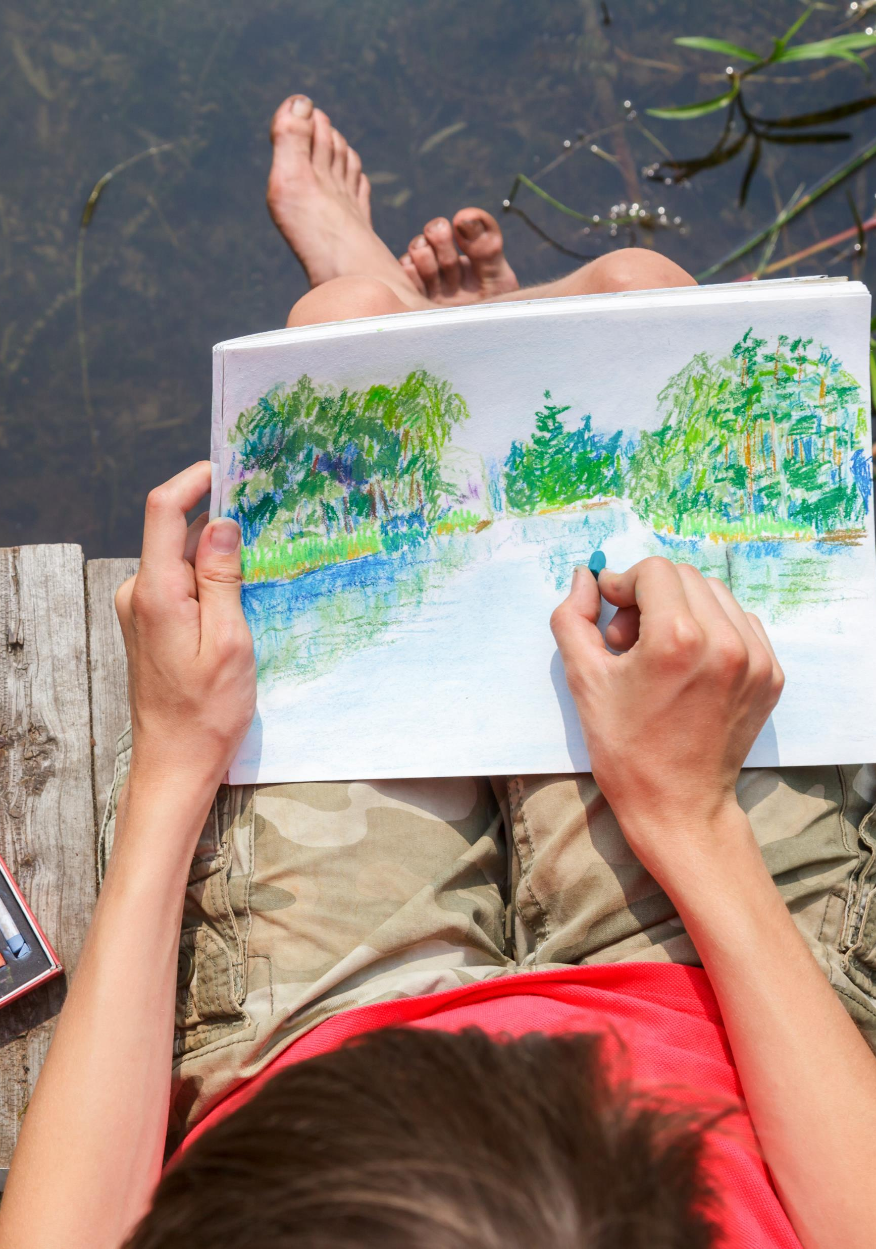
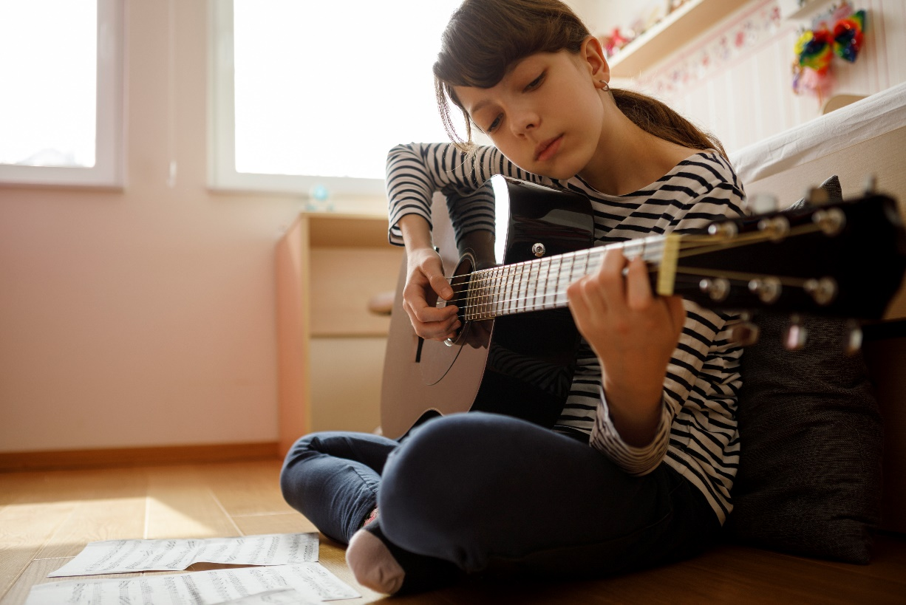
What hobbies do you have?
What do you like to do in your free time? Why?
What about the members of your family?

Slide 3
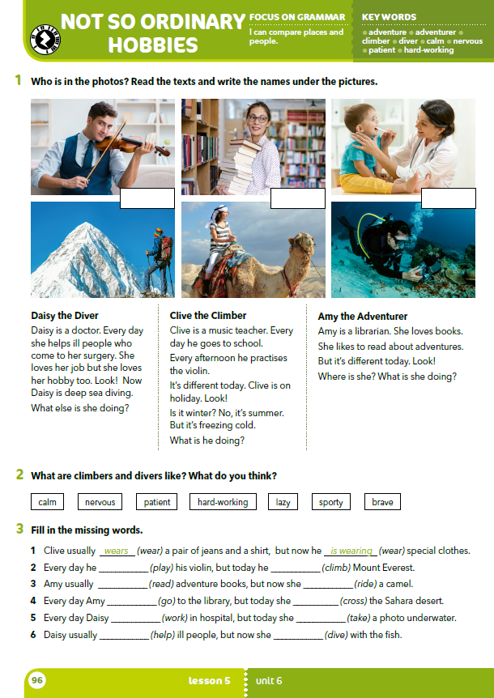
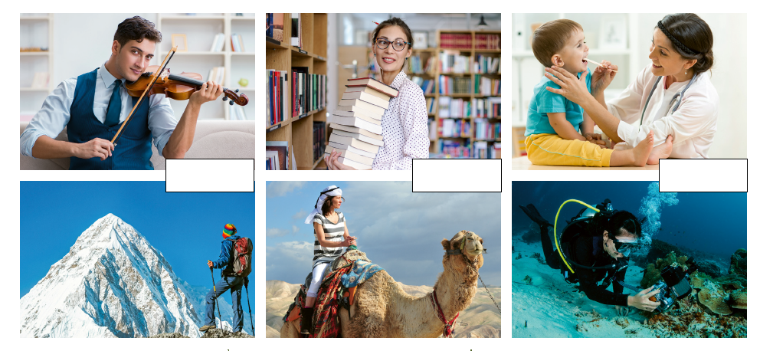
What can you see in the photos?

Slide 4
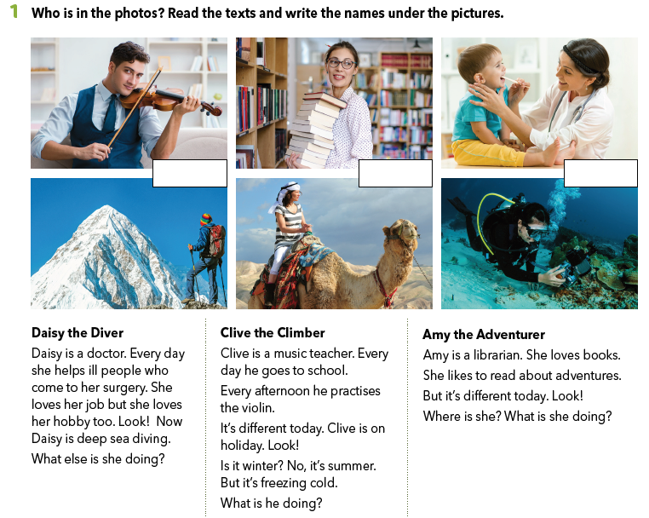
Clive the Climber
Amy the Adventurer
Daisy the Diver

Slide 5
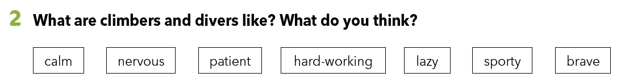
Use the adjectives from task 2 and describe the people in the photos.
Who is calm?
Who is nervous?
Is Daisy calmer than Amy?
Is Clive more nervous than Daisy?...
Write three sentences in which you’ll compare the characters from the texts.

Slide 6
Read the texts once again and answer the questions at the end of each text.
Write the answers in your notebook.

Slide 7
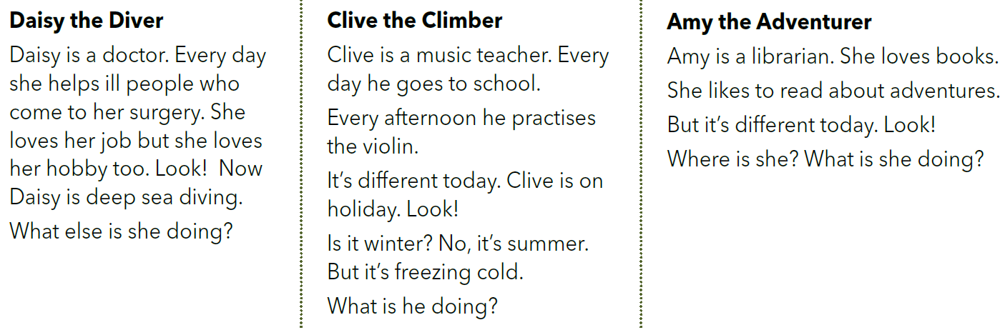
Underline the answers in the text.
When do we use the present simple tense?
What does Daisy do every day?
What does Clive do every day?
What does Amy love ?
We use the present simple tense to talk about:
our habits and hobbies, things we do regularly
what we think, like and feel
What tense is used in these sentences?
The present simple tense.

Slide 8
Read your answers to the questions from the texts once again.
Daisy is taking a photo.
Clive is hiking.
Amy is riding a camel.
Underline the verbs in the sentences.
What tense is used in these sentences?
The present continuous tense.

Slide 9
Daisy is taking a photo.
Clive is hiking.
Amy is riding a camel.
When do we use the present continuous tense?
We use the present continuous tense to talk about:
actions that are happening now

Slide 10
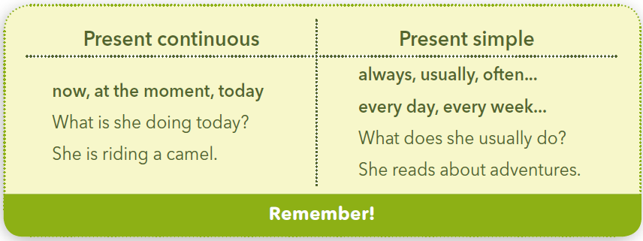
Zapamti!

Slide 11
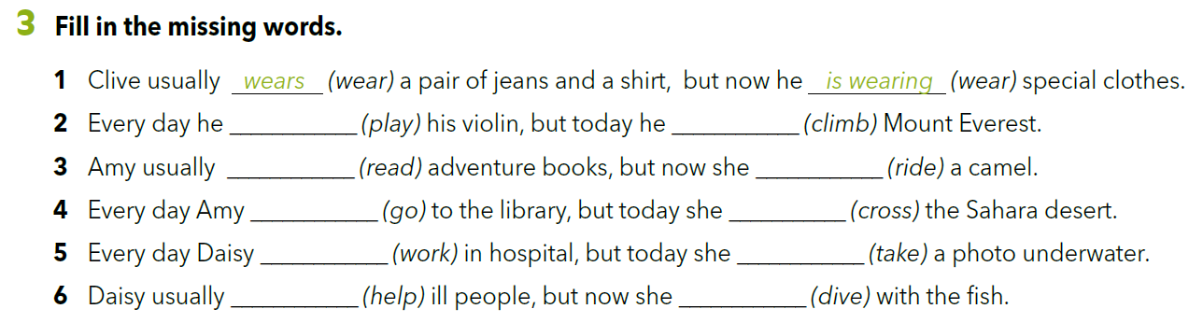
plays
is playing
reads
is riding
goes
is crossing
works
is taking
helps
is diving

Slide 12
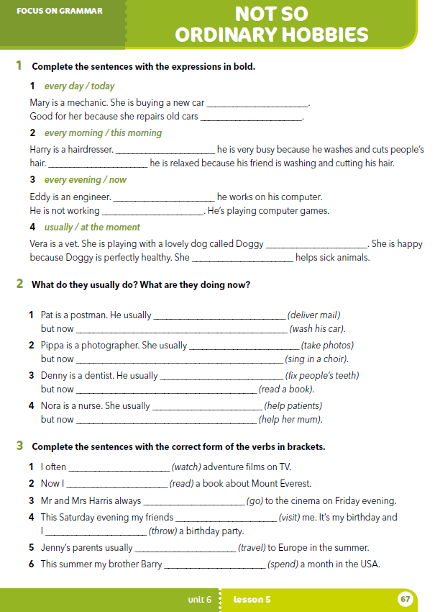
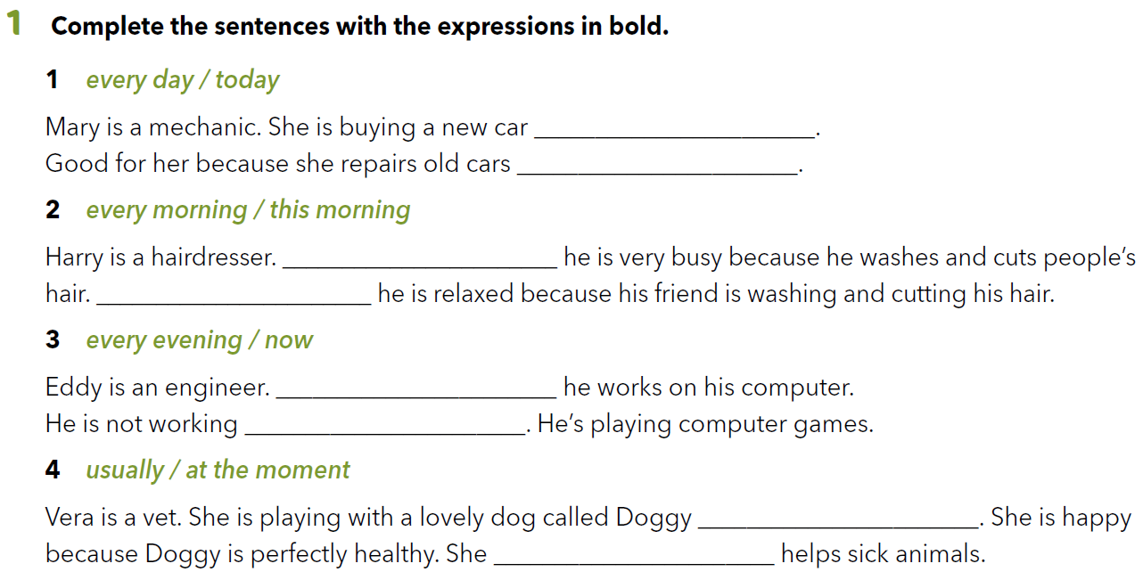
Workbook p. 67
today
every day
Every morning
This morning
Every evening
now
at the moment
usually

Slide 13
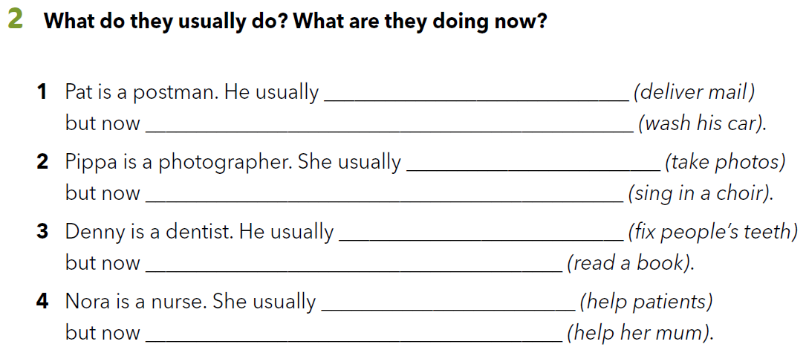
delivers mail
he is washing his car
takes photos
she is singing in a choir
fixes people’s teeth
he is reading a book
helps patients
she is helping her mum

Slide 14
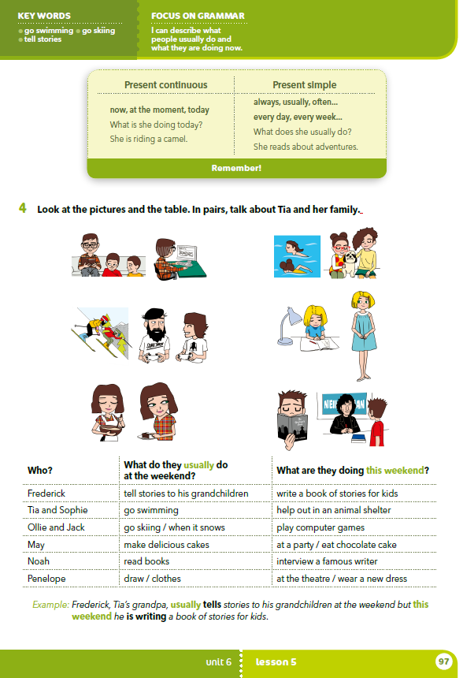
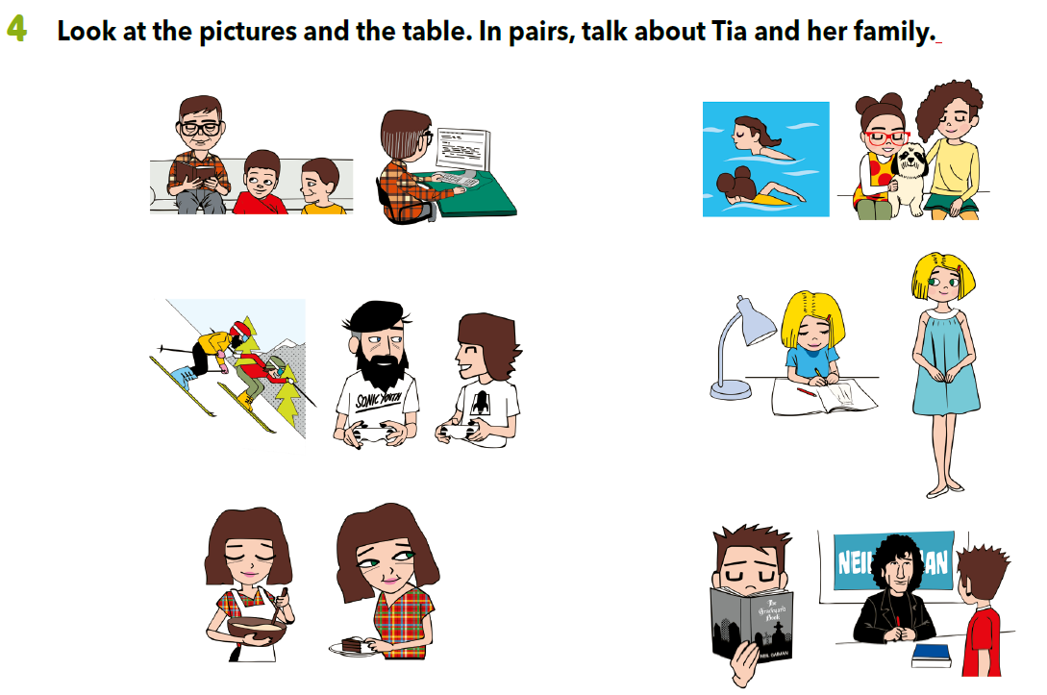
Describe the pictures.
What are they wearing?
What are they doing?

Slide 15
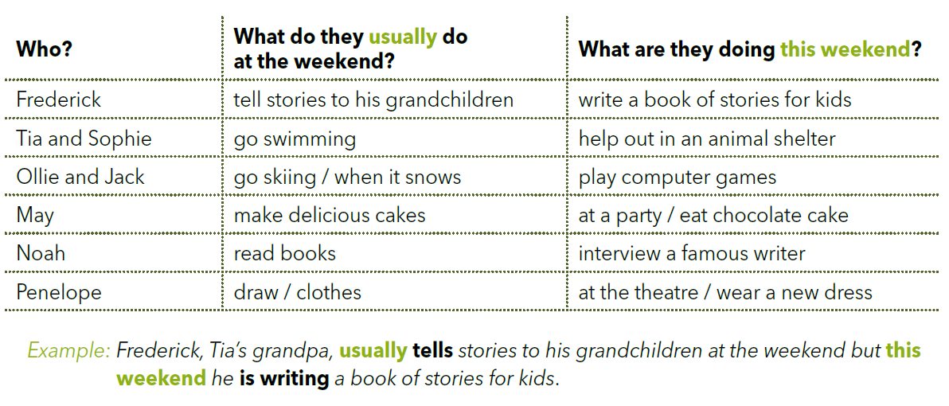
Use the information from the chart and write the sentences about Tia and her family/friends in your notebook.
https://learningapps.org/watch?v=pbq9fetqc18

Slide 16
PROJECT TIME!
Look around yourself. What are the people that you see doing right now?
What do they usually do? Imagine you are a reporter.
Find 8 people who are doing different things and interview them.
Write the sentences about them and draw people or symbols which show what they are doing at that moment or what they usually do.
Present your work to your classmates.

Slide 17
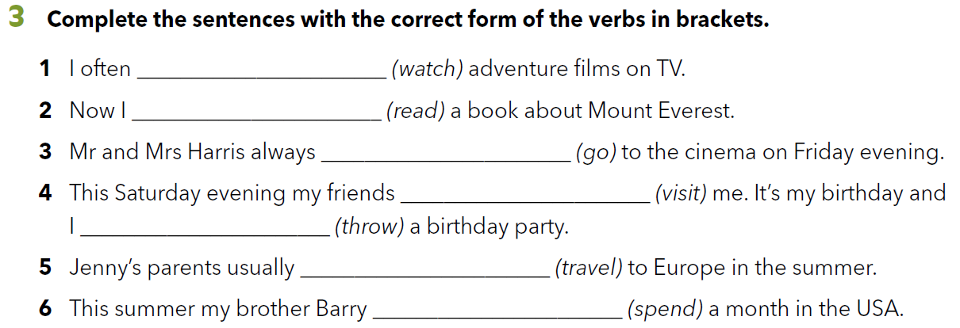
Workbook p. 67
watch
am reading
go
are visiting
am throwing
travel
are spending

Slide 18

LET’S REVISE!
PLAY AND LEARN.
https://learningapps.org/watch?v=p1azcrehn18
LEARN MORE.
https://www.e-sfera.hr/dodatni-digitalni-sadrzaji/f8865d1a-3f8d-4dd7-8713-ad872864f9e2/
The secret life of pets

Slide 19
SELF CHECK
https://www.e-sfera.hr/dodatni-digitalni-sadrzaji/f8865d1a-3f8d-4dd7-8713-ad872864f9e2/

